Slide 1
TELECOM CUSTOMER CHURN PREDICTIONY
By:
Deepali Jain
Ashisha H Jiji Sam
Arthi J
(DS C51 IIIT-B Upgrad)

Slide 2

TELECOM CUSTOMER CHURN PREDICTION
BACKGROUND
In the telecom industry, customers are able to choose from multiple service providers and actively switch from one operator to another. In this highly competitive market, the telecommunications industry experiences an average of 15-25% annual churn rate. Given the fact that it costs 5-10 times more to acquire a new customer than to retain an existing one, customer retention has now become even more important than customer acquisition.
For many incumbent operators, retaining high profitable customers is the number one business goal.
To reduce customer churn, telecom companies need to predict which customers are at high risk of churn.
In this project, we will analyse customer-level data of a leading telecom firm, build predictive models to identify customers at high risk of churn and identify the main indicators of churn.

Slide 3
Observations
1. Train set
Accuracy = 0.84
Sensitivity = 0.81
Specificity = 0.83
2. Test set
Accuracy = 0.78
Sensitivity = 0.82
Specificity = 0.78
Overall, the model is performing well in the test set, what it had learnt from the train set.

Slide 4
Final Conclusion
We can see that the logistic model with no PCA has good sensitivity and accuracy, which are comparable to the models with PCA. So, we can go for the more simplistic model such as logistic regression with PCA as it explains the important predictor variables as well as the significance of each variable. The model also hels us to identify the variables which should be act upon for making the decision of the to be churned customers. Hence, the model is more relevant in terms of explaining to the business.

Slide 5
Business recommendation
Target the customers, whose minutes of usage of the incoming local calls and outgoing ISD calls are less in the action phase (mostly in the month of August).
Target the customers, whose outgoing others charge in July and incoming others on August are less.
Also, the customers having value-based cost in the action phase increased are more likely to churn than the other customers. Hence, these customers may be a good target to provide offer.
Customers, who's monthly 3G recharge in August is more, are likely to be churned.
Customers having decreasing STD incoming minutes of usage for operators T to fixed lines of T for the month of August are more likely to churn.
Customers decreasing monthly 2g usage for August are most probable to churn.
Customers having decreasing incoming minutes of usage for operators T to fixed lines of T for August are more likely to churn.
roam_og_mou_8 variables have positive coefficients (0.7135). That means for the customers, whose roaming outgoing minutes of usage is increasing are more likely to churn.
Business recomendation

Slide 6
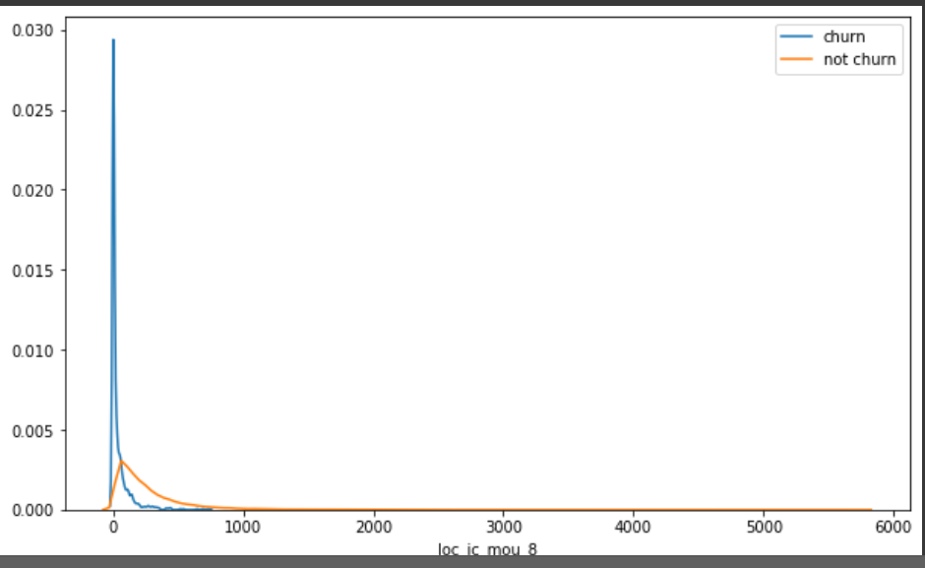
Plots of important predictors for churn and non churn customers
We can see that for the churn customers the minutes of usage for the month of August is mostly populated on the lower side than the non churn customers.

